Slide 1
INTRODUCTION
Purpose of the Project:
The project aims to analyze medical insurance costs using advanced data analytics techniques, focusing on how demographic and health-related features influence these costs.
Importance of the Study:
Healthcare economics is increasingly impacted by the rising costs of medical insurance, affecting policy-makers, insurance companies, and consumers alike. This study provides insights that could lead to more informed decisions and strategies.
Project Objectives:
Develop a predictive model to accurately estimate medical insurance costs.
Identify key factors that influence these costs and analyze their patterns.
Offer actionable recommendations to stakeholders for informed decision-making.

Slide 2
Data Overview
Dataset Description:
The project utilizes a comprehensive Medical Insurance dataset, consisting of 1,340 records, detailing various factors that influence health insurance costs.
Key Variables:
Key variables analyzed include Age, Sex, BMI, Children, Smoker, Region, and Annual Medical Charges.
Relevance to the Project:
This dataset is critical as it encapsulates significant factors like smoking status and BMI, known to impact insurance costs substantially, allowing us to draw actionable insights into cost prediction and policy formulation.

Slide 3
Data Preparation and Processing
Cleaning and Preprocessing:
Checked for and handled missing values.
Removed duplicate entries to ensure data integrity.
Corrected data format inconsistencies across different variables.
Feature Engineering:
Introduced a new variable, 'BMI_Category', to classify individuals into risk groups based on their BMI, enhancing model's predictive capability.
Normalization:
Applied StandardScaler to normalize the features 'Age' and 'BMI', ensuring they contribute equally to model performance

Slide 4
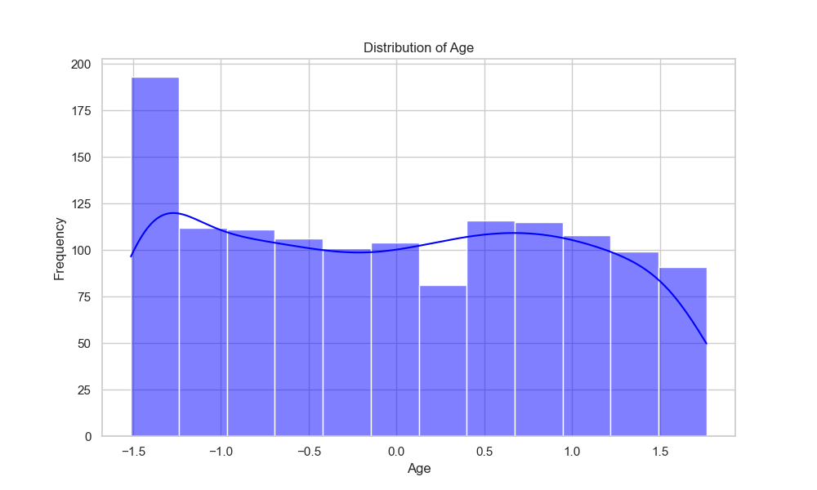
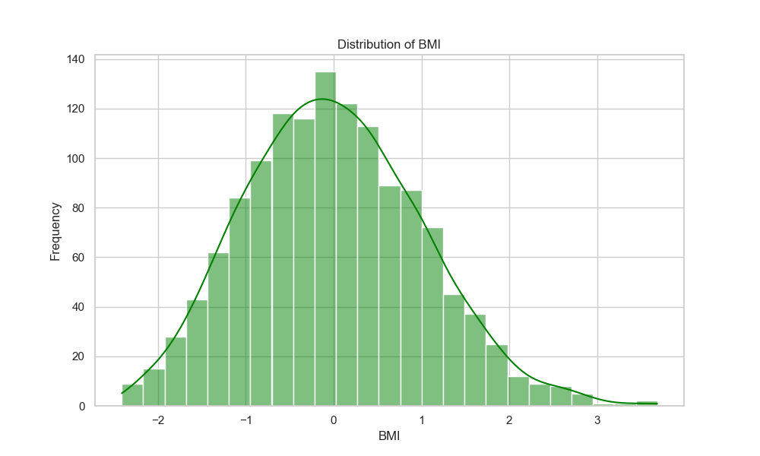
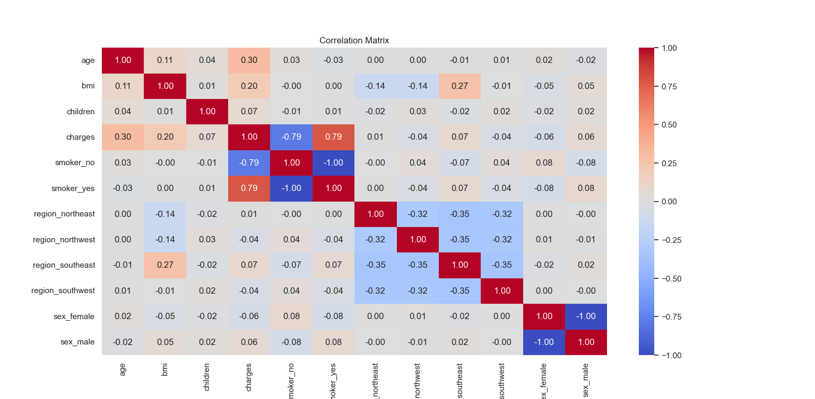
Exploratory Data Analysis (EDA)
Key findings:
Age and BMI distributions showed expected trends and helped identify outliers."
"Smoking status is a significant predictor of insurance costs, with smokers incurring much higher costs."
"Visualized correlations between features to identify potential predictors for insurance costs."
Techniques Used:
Histograms for univariate analysis."
"Box plots to explore impacts of categorical variables like 'Smoker' and 'Region'."
"Heatmaps to understand feature correlations.

Slide 5
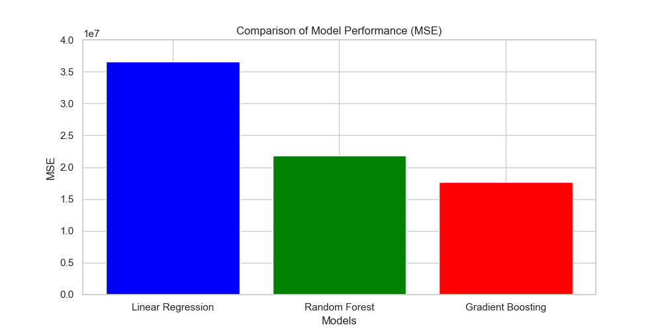
Model Development
Models Tested:
Linear Regression: Served as the baseline model."
"Random Forest Regressor: Handled complex non-linear relationships effectively."
"Gradient Boosting Regressor: Best performance with the lowest MSE, demonstrating strong capability in modeling complex patterns.
Model Selection:
Chose Gradient Boosting
based on its superior performance
in terms of
Mean Squared Error (MSE).
Model Evaluation:
Evaluated models
based on MSE to compare
accuracy and determine
the best performer.

Slide 6

Analysis of Results
Assessed and compared the performance of all developed models using Mean Squared Error (MSE) as a key metric.
Performance Summary:
Linear Regression: MSE = 36,566,257.20
Random Forest Regressor: MSE = 21,801,949.93
Gradient Boosting Regressor: MSE = 17,714,020.23
The Gradient Boosting Regressor showed the best performance
with the lowest MSE, indicating its effectiveness in
handling complex datasets with non-linear relationships.

Slide 7
Policy Implications
The study’s findings offer actionable insights for stakeholders in the healthcare insurance industry.
Strategic Decisions:
Enhanced risk assessment allowing for more accurate premium setting.
Identification of key cost-driving factors enables targeted interventions to manage expenses.
Policy Development:
Data-driven insights can inform policy decisions, leading to the formulation of policies that ensure fair insurance practices."
"Potential to influence public health initiatives by highlighting preventable cost factors such as smoking.

Slide 8
Limitations and Future Research
Limitations:
The scope of data may limit the generalizability of the findings.
Potential biases inherent in the dataset could have influenced the results.
Future Research Directions:
Incorporation of additional variables such as lifestyle factors and pre-existing conditions to enhance model robustness."
"Expansion to larger and more diverse datasets to improve the applicability and accuracy of the findings."
"Longitudinal studies to assess the impact of policy changes over time.

Slide 9
Conclusion
Summarize the key findings and the importance of the predictive models developed.
Reiterate how the project achieved its objectives, including the development of a model that provides accurate predictions of medical insurance costs.
Highlight the successful application of object-oriented principles and data analytics in addressing real-world problems in healthcare economics.
Emphasize the potential impact of your findings on healthcare policy and insurance practices.
Call to Action:
Encourage continued research and adoption of data-driven approaches in the healthcare industry."
"Invite stakeholders to consider integrating advanced analytics into their operational and decision-making processes.

Slide 10


